Slide 1
Python SMS
Assignment
Jandré Pretorius
Notes:
Explain interpretation of Assignment, three parts
Next slide ~ improvements of original sms app

Slide 2
“… assignment extends on the basic regular expressions assignment..”
Original SMS App Optimization
lower() directly from file input
RE objects
Called RE objects later in code
Removed punctuation w/RE not FOR loop
Notes:
What I did to optimize
Next slide punctuation

Slide 3
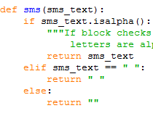
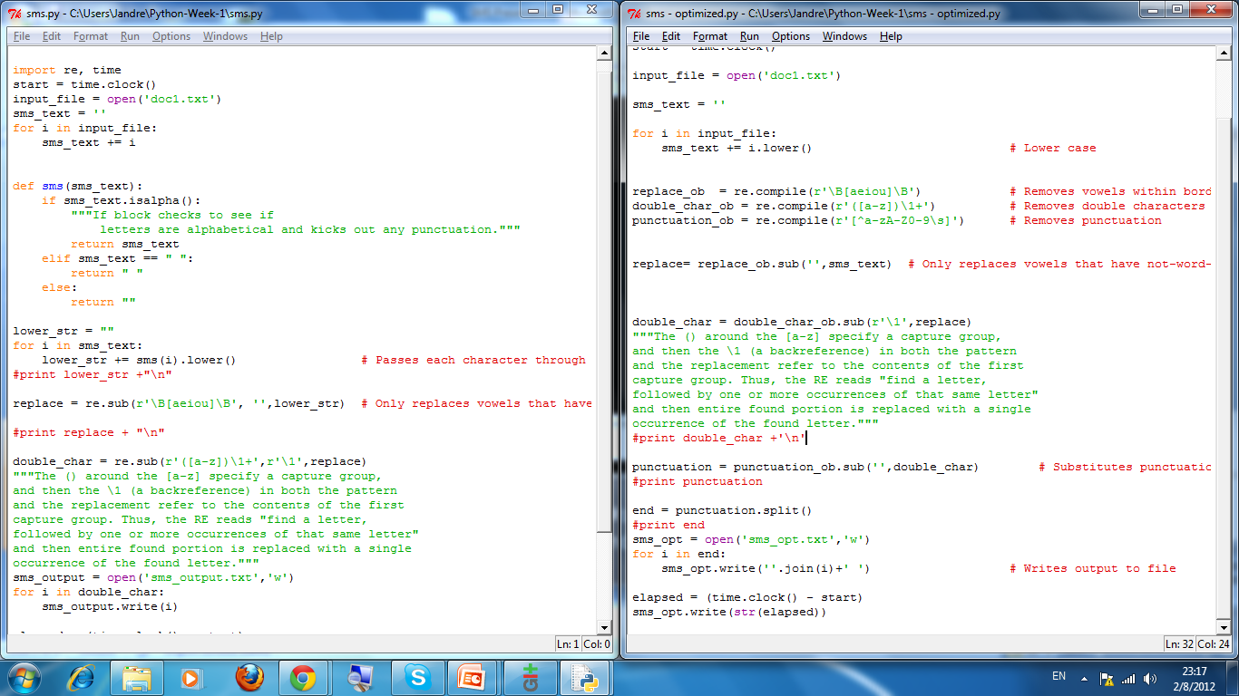
“… assignment extends on the basic regular expressions assignment..”
Punctuation
Notes:
Left is original sms punctuation removal
Right is optimized
Next slide RE objects

Slide 4
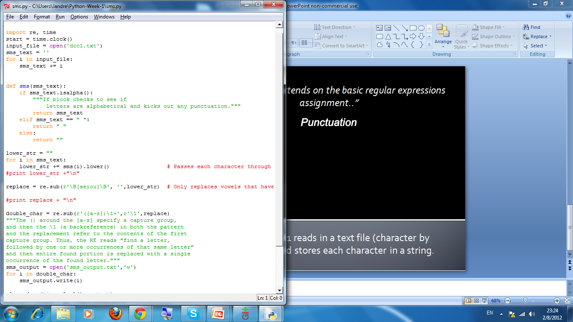
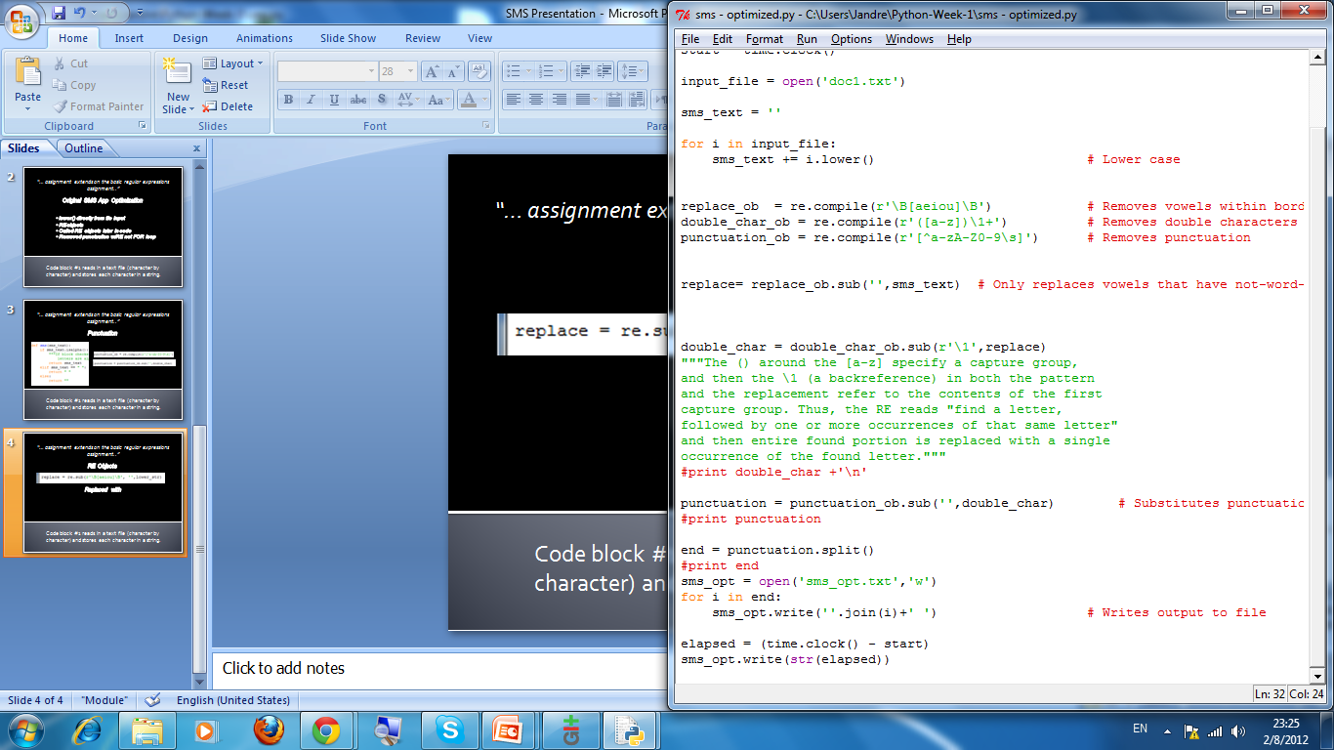
“… assignment extends on the basic regular expressions assignment..”
RE Objects
Replaced with
Notes:
Created objects and called them later in the project

Slide 5
“… assignment extends on the basic regular expressions assignment..”
Execution: Both write output to file
Original
Optimized
6.09309149552 seconds
3.33483023752 seconds
45% improvement
Notes:
Left is original sms app
Right is optimized version
45% improvement

Slide 6
“… assignment extends on the basic regular expressions assignment..”
Book Translation
Normalize text + save list version
Pass through RE filters + save list version
Create file with SMS versions
Retranslate SMS using dictionary made from saved strings
Measure accuracy
Notes:
Normalize text + save list version
Pass through RE filters + save list version
Create file with SMS versions
Retranslate SMS using dictionary made from saved strings
Measure accuracy

Slide 7
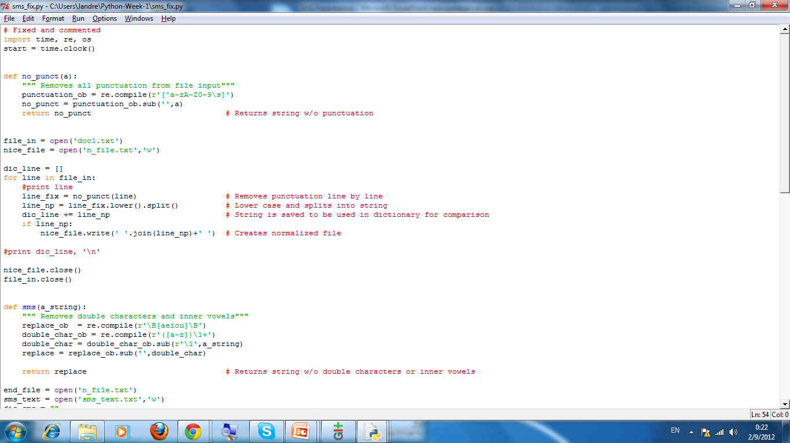
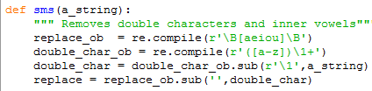
“… assignment extends on the basic regular expressions assignment..”
Normalize and filter
Notes:
Remove punctuation and save a list copy
Pass through filter and save another list copy

Slide 8
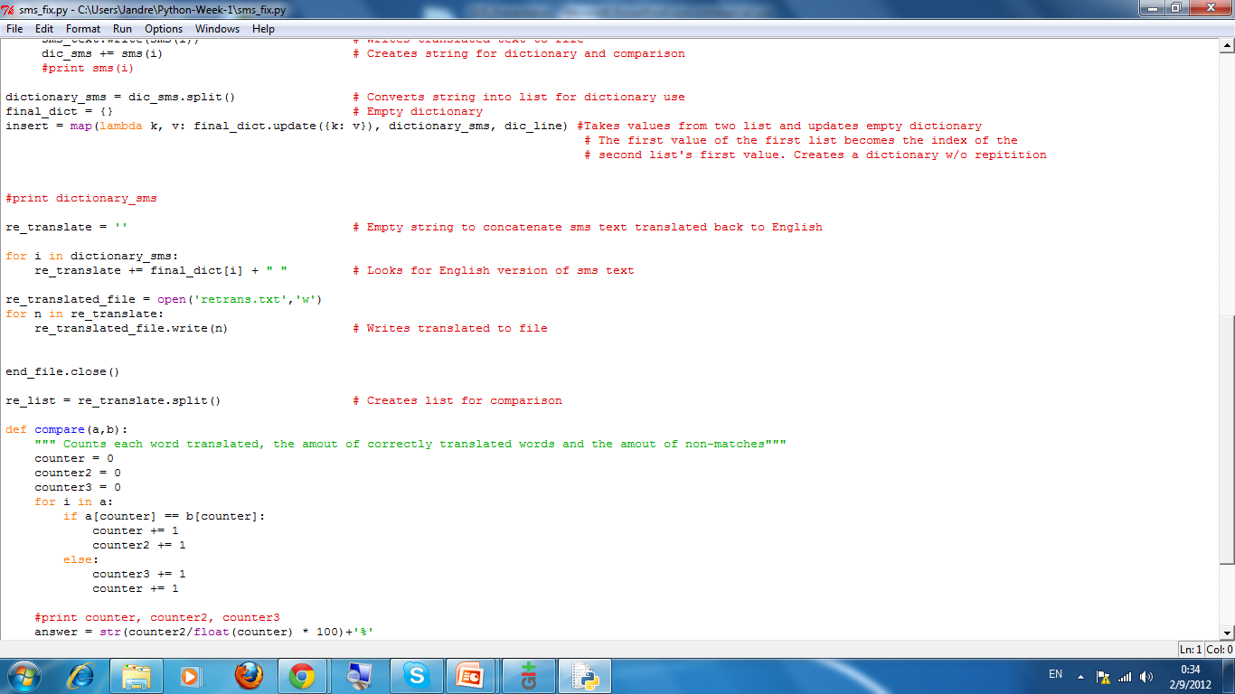
“… assignment extends on the basic regular expressions assignment..”
Create lists and dictionary
Normalized list for dictionary =
Dictionary value
Filtered list for dictionary =
Dictionary key
Map function updates an empty dictionary and ensures no doubles
Lambda = one line, no name function
Notes:
Create dictionary from two lists using maping and update

Slide 9
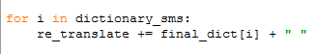
“… assignment extends on the basic regular expressions assignment..”
Translate SMS to English w/Dictionary
Look up SMS version (key) and return English (value)
Notes:
Re-translate

Slide 10
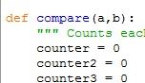
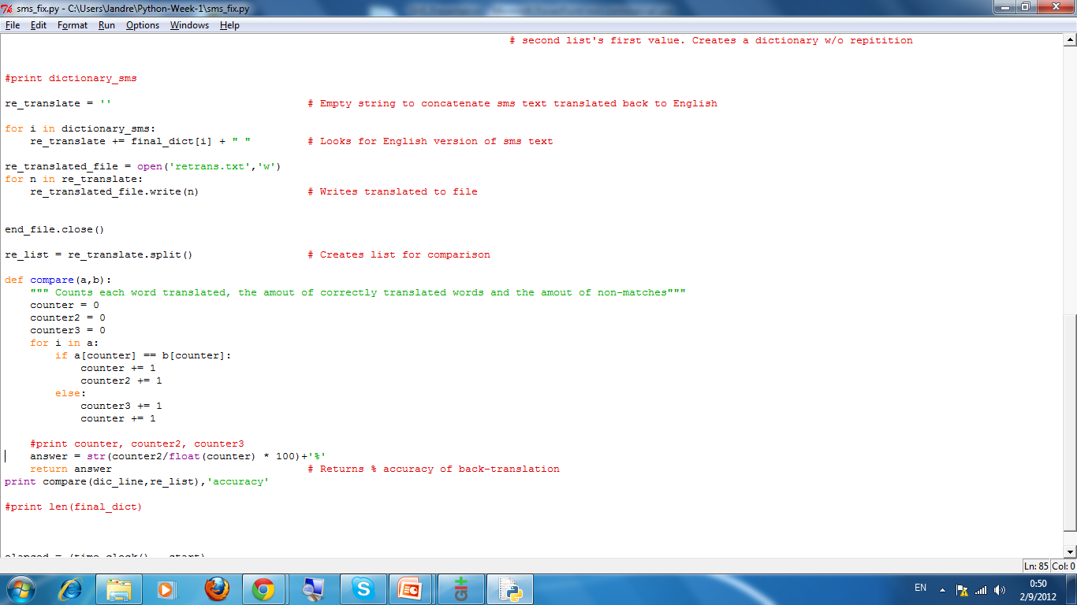
“… assignment extends on the basic regular expressions assignment..”
Measure Accuracy
Count every word attempted to translate
Count every successful translation
Count every failed translation
Divide successful with total x 100 = Accuracy%
Notes:
Accuracy measure

Slide 11
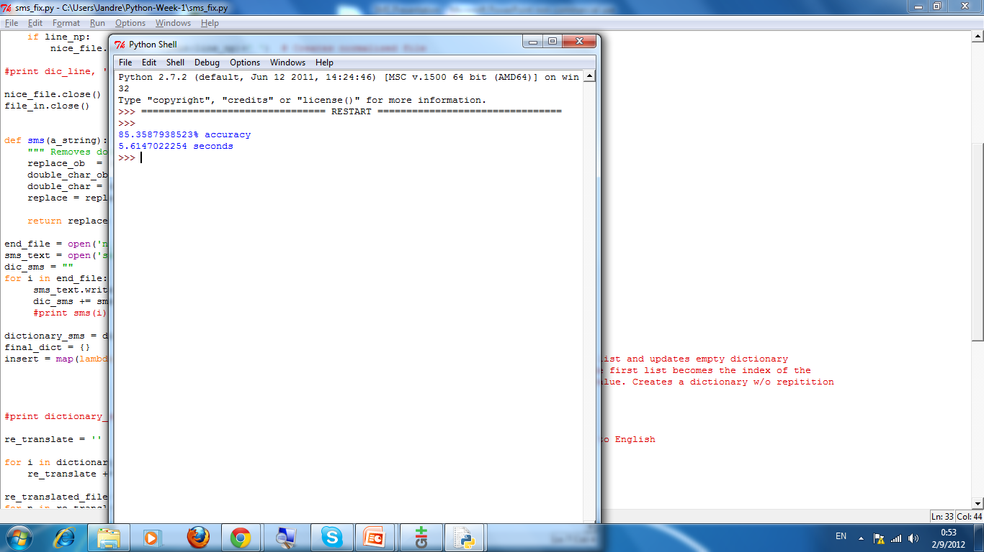
“… assignment extends on the basic regular expressions assignment..”
Measure Accuracy
Notes:
All four e-books, best result

